Slide 1



DSETA: Driving Style-Aware Estimated Time of Arrival
Authors: Bolin Zhang¹, Zhidan Liu*²

Slide 2

Introduction
Estimated Time of Arrival (ETA)
The applications served by ETA
  Map navigation
  Instant delivery services
  Online ride-hailing platforms
  Vehicle dispatch systems
Departure time: 11:00 am
Origin
ETA: 20 min
Planned
travel route
The benefits of accurate ETA
  Boost transportation efficiency
  Enhance user experiences
  Promote environmental sustainability
Destination
Notes:
Estimated time of arrival (ETA) is designed to forecast the travel duration from a specified origin to a destination along a planned travel route, taking into account a particular departure time.
As a crucial component of location-based services, ETA is extensively utilized in a variety of contemporary mobility and transportation applications, including map navigation, instant delivery services, online ride-hailing platforms, and vehicle dispatch systems.
Accurate ETA predictions can greatly boost transportation efficiency, enhance user experiences, and promote environmental sustainability by reducing energy consumption.
Despite significant research advancements in ETA prediction, most existing methods overlook the impact of individual driving habits and preferences, referred to as driving style.

Slide 3
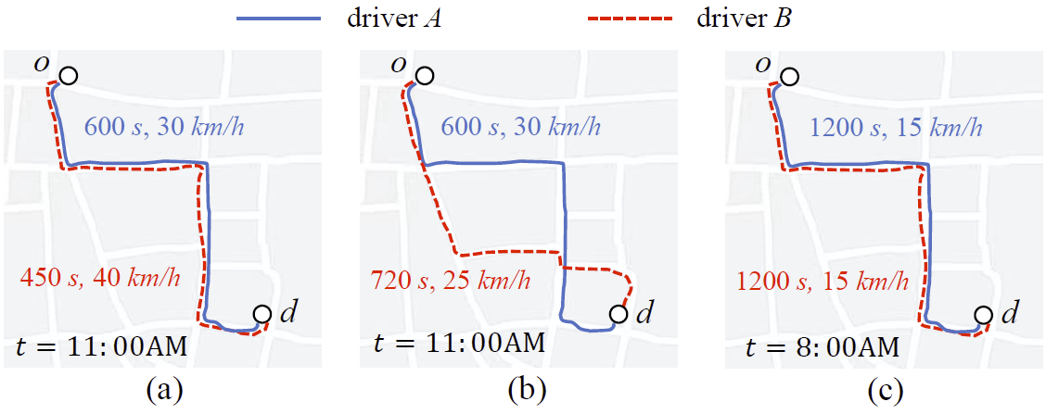
Introduction
Driving Style
Driving style affects ETA
Driving style should not be viewed as simply fast or slow
Spatio-temporal factors also influence ETA
Notes:
Driving style plays an important role in ETA. Figure (a) shows that drivers can experience notably different travel times for identical trips, even with the same origin, destination, and departure time.
Some previous works only used a single speed value to simply represent driving style. However, driving style should not be viewed as simply fast or slow, but as a distribution of speeds under varying circumstances. For example, Figure (b) further shows that driver B takes an alternative route with the same travel distance between the same origin and destination. However, this route takes longer due to a lower average speed on unfamiliar roads compared to the original route.
In addition to driving style, external factors such as origin and destination locations, road types, and departure time significantly influence travel time. For example, as shown in Figure (c), even an aggressive driver cannot maintain high speeds on congested roads during peak traffic hours.

Slide 4
Introduction
Core Challenges
How to effectively represent driver’s driving style for ETA predictions?
How to dynamically adjust the impacts of driving style and various factors on ETA predictions?
How to efficiently train the model to achieve accurate ETA predictions?
Notes:
The phenomena mentioned above motivate the need for a driving-style-aware ETA method, but its implementation faces following key challenges.
First, how to effectively represent driver’s driving style for ETA predictions?
Second, how to dynamically adjust the impacts of driving style and various factors on ETA predictions?
Third, how to efficiently train the model to achieve accurate ETA predictions?

Slide 5
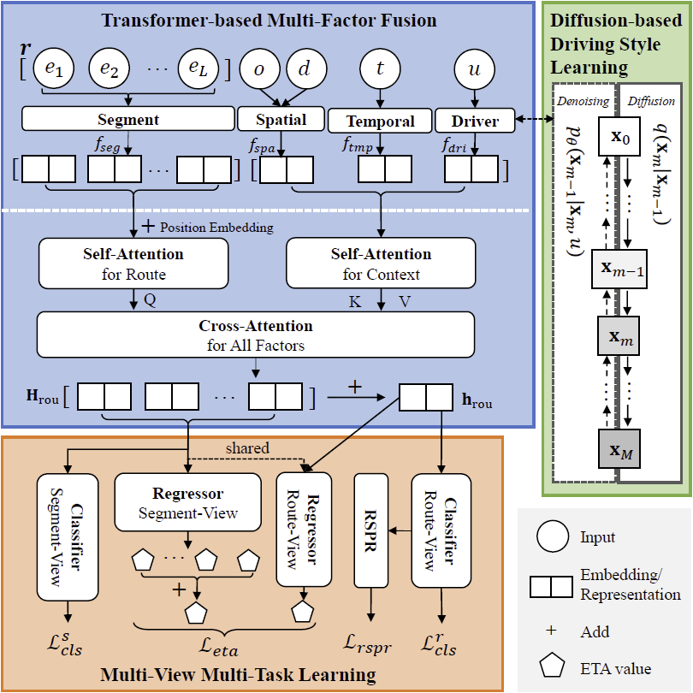
Framework Overview
Notes:
To address above problem, we propose a novel ETA learning approach – DSETA. As illustrated in Figure 2, DSETA comprises three key modules.
First, the Diffusion-based Driving Style Learning module generates Distance-Duration Pairs (DDPs), enabling the extraction of implicit driving style representations for drivers.
Next, the Transformer-based Multi-Factor Fusion module integrates learned driving styles with spatial-temporal factors to enhance ETA predictions.
Finally, the Multi-View Multi-Task (MVMT) Learning module incorporates auxiliary tasks focusing on driving style from both route and segment perspectives, thereby supporting and improving the ETA learning task.

Slide 6
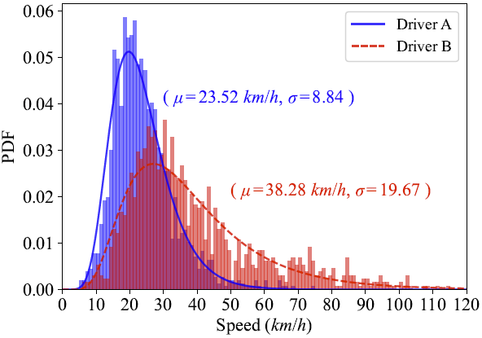
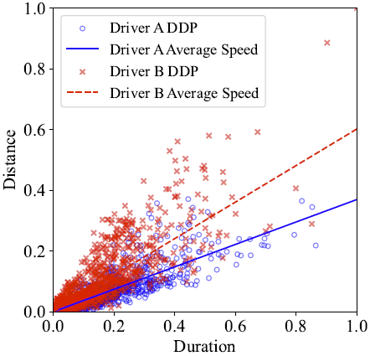
DSETA
Diffusion-based Driving Style Learning
Using speed distribution to better represent driving style
A single average speed is insufficient to represent driving style
Fig (a). Statistics on the trip data for tow drivers.
Fig (b). Visualization of DDPs.
Notes:
Instead of a single average speed, we propose using speed distribution to better represent driving style. Analyzing drivers A and B from a real-world dataset, we show in Figure (a) that driver B, despite a higher average speed, has a broader speed distribution, indicating frequent speed adjustments due to changing conditions.
To analyze trip characteristics, we generate distance-duration pairs (DDPs) for drivers A and B, as visualized in Figure (b) with Min-Max normalization, while overlaying the average speeds. The DDP dispersion indicates that a single average speed is insufficient to represent driving style across varying distances and durations. Thus, DDPs are proposed as a better representation.

Slide 7
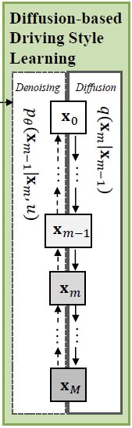
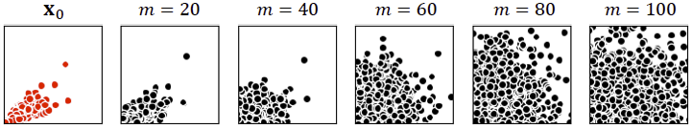
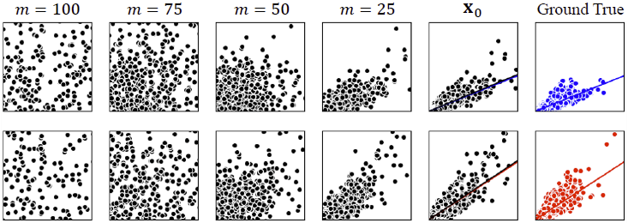
DSETA
Diffusion-based Driving Style Learning
Diffusion process
Denoising process
Notes:
However, DDPs’ discrete nature and the impracticality of modeling them with functions for integration with deep learning-based ETA prediction frameworks lead us to propose a DDP generation task. This task synthesizes DDPs based on actual speed distributions, indirectly encoding driver information along with driving style semantics.
Drawing on the generative capabilities of diffusion models, we develop a DDP generation model using Denoising Diffusion Probabilistic Models which including diffusion process and denoising process.
Upon completion of DDP generation training, we obtain driver features imbued with driving style semantics.

Slide 8
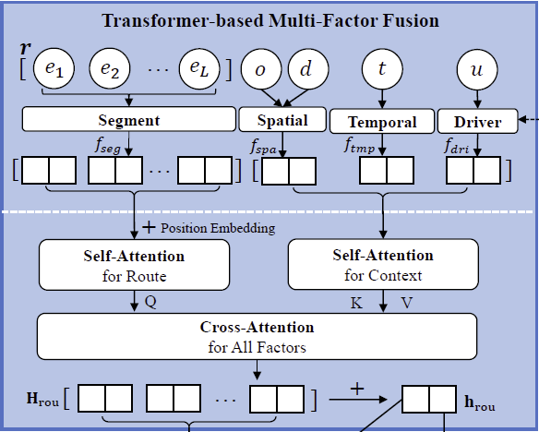
DSETA
Transformer-based Multi-Factor Fusion
DSETA adjusts the weights assigned to spatio-temporal factors and driving styles using attention mechanisms
Notes:
In addition to driver driving style, several other factors influence the travel time of a trip, including the origin and destination, departure time, and the travel route.
To incorporate these factors and assess their impacts on the ETA prediction, DSETA adjusts the weights assigned to these factors in determining ETA using attention mechanisms.

Slide 9
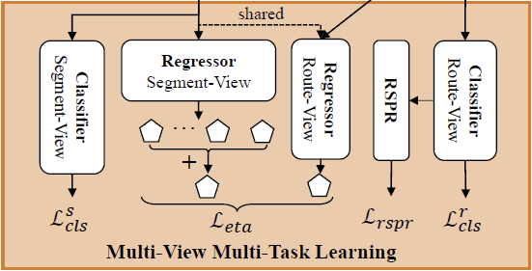
DSETA
Multi-View Multi-Task Learning
ETA Learning Tasks
Driving Style Classification Tasks
  Route-view speed distribution classification
  Route-level speed prior regularization (PSPR)
  Segment-view relative speed classification
Joint Optimization
Notes:
To achieve robust and accurate ETA predictions, we propose the Multi-View Multi-Task learning framework. This framework integrates auxiliary tasks for driving style classification to support the main task of ETA learning. The learning process is conducted at both the route view and the segment view, thereby enhancing the driving style-aware ETA predictions by taking into account the influences of global route characteristics as well as local segment details.

Slide 10
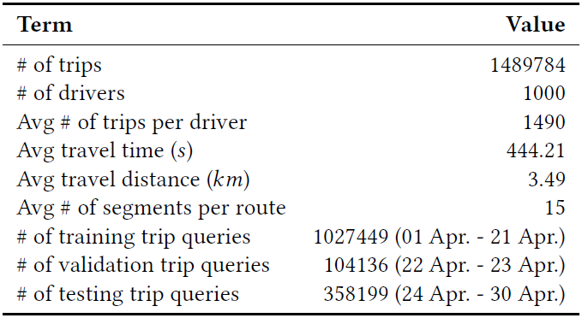
Experiments
Dataset
Experiments on a large, real-world anonymous trip trajectory dataset
Table. Statistics of the real-world trip dataset.
Notes:
We conduct experiments using a large, real-world anonymous trip trajectory dataset collected in Shanghai city, China, in April 2015. This dataset comprises nearly 1.5 million trips generated by 1000 drivers.

Slide 11
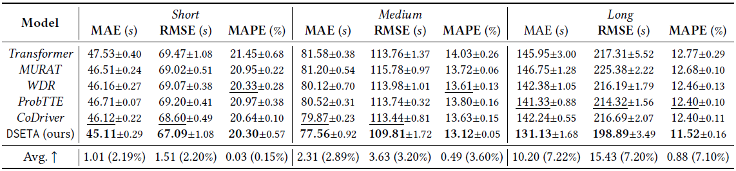
Experiments
Performance Comparison
DSETA achieves the best performance across all three trip categories and metrics
Table. Performance comparison of different approaches across varying travel distances.
Notes:
To gain a deeper understanding of the performance of various methods across different types of trips, we categorize the testing trips based on travel distance into three groups, as shown in the table. DSETA achieves the best performance across all trip categories and metrics.

Slide 12
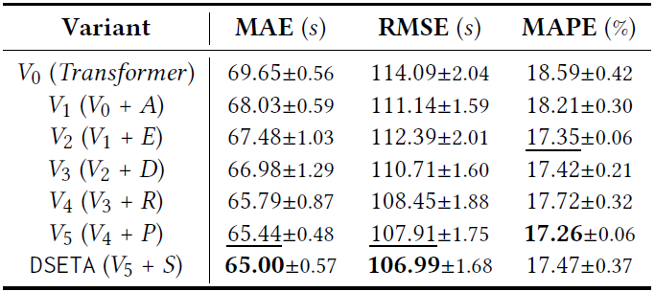
Experiments
Ablation Study
Improvement in prediction accuracy obtained by different modules
Table. Performance comparison among DSETA variants
Notes:
To evaluate the effectiveness of our design, we systematically incorporate components into the original Transformer architecture, which serves as the baseline variant 𝑉0. This incremental approach generates various variants, ultimately culminating in the complete DSETA design.
The table shows the improvement in prediction accuracy obtained by different modules.

Slide 13
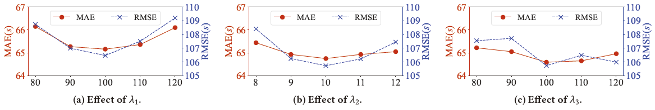
Experiments
Impact of Hyperparameters
Determination of 𝜆1, 𝜆2, and 𝜆3
Figure. Impact of hyperparameter settings for 𝜆1, 𝜆2, and 𝜆3.
Notes:
We sequentially determine the optimal values for 𝜆1, 𝜆2, and 𝜆3. Once a hyperparameter is established, we fix its value and proceed to identify the next one in the sequence.

Slide 14
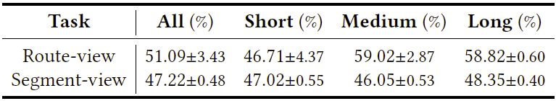
Experiments
Performance of Auxiliary Tasks
Both auxiliary driving style classification tasks have learned the designed semantics
Table. Accuracy of auxiliary classification tasks.
Notes:
We conduct experiments to evaluate two auxiliary driving style classification tasks accuracies, with results presented in the table. Both auxiliary tasks have learned the designed semantics.

Slide 15
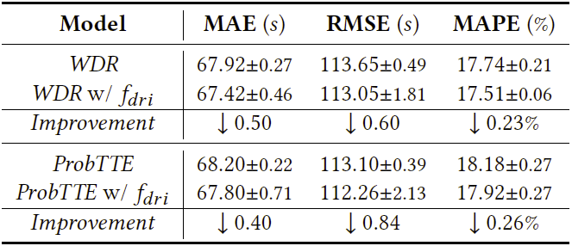
Experiments
Effectiveness of Driving Style Embedding
Generalization of driving style representation
Table. Performance comparison between the original model and the one enhanced with our driver embedding.
Notes:
More experiments show that our driving style representation, learned through the DDP generation task, can be effectively integrated with other ETA prediction methods.

Slide 16
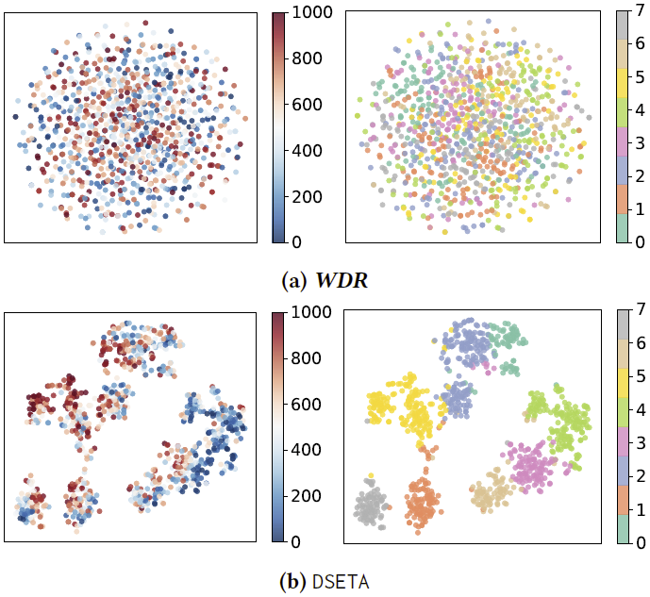
Experiments
Effectiveness of Driving Style Embedding
DSETA effectively captures speed-related driving style semantics
Figure. t-SNE visualization of driver embeddings
Notes:
And DSETA effectively captures speed-related driving style semantics, enabling clear driver categorization and labeling.

Slide 17
Conclusion
We design the DDP generation task and employ a diffusion model to learn driving style representations.
We present DSETA, a driving style-aware ETA approach that utilizes attention mechanisms to explore the relationships between spatio-temporal factors and driving styles.
We propose a multi-view multi-task learning framework that incorporates several auxiliary tasks to guide driving style learning and enhance ETA predictions.
Extensive experiments on a large real-world dataset have validated the effectiveness of our approach.
Notes:
In summary, we design the DDP generation task and employ a diffusion model to learn driving style representations. This representation enables deep learning models to effectively embed semantics related to practical driving styles.
We introduce DSETA, a driving style-aware ETA approach that utilizes attention mechanisms to explore the relationships between spatio-temporal factors and driving styles.
We propose a multi-view multi-task learning framework that incorporates several auxiliary tasks to guide driving style learning and enhance ETA predictions. Additionally, we devise the PSPR to improve the model’s generalization capabilities.
Extensive experiments on a large real-world dataset have validated the effectiveness of our approach.

Slide 18
Thank you for you listening!
Bolin Zhang, SZU
zhangbolin2023@email.szu.edu.cn
Zhidan LIU, HKUST (Guangzhou)
zhidanliu@hkust-gz.edu.cn
https://liuzhidan.github.io/
Notes:
If you have any questions, you are welcome to contact the authors.

